Slide 1
Differential Privacy for Subgroup Analysis: Opportunities and Challenges for Publishing Rheumatoid Arthritis Data
MSc. Data Science Ahmet Akkoç

Slide 2
What is Rheumatoid Arthritis (RA)?
Rheumatoid arthritis (RA) is a chronic and progressive auto-immune disorder that affects the joints, leading to inflammation, pain, and stiffness. RA can significantly impact daily activities, such as work, household tasks, and leisure activities. The disease can also have a substantial negative impact on a person’s quality of life (QoL) due to pain, fatigue, and decreased mobility.
It is estimated that RA affects approximately 5 per 1000 adults worldwide, with women being more affected than men (Aletaha and Smolen, 2018).
Because RA is a chronic and progressive condition, treatment strategies are planned and executed over the course of several months; therefore often time-series data is required.
Notes:
Pages 3-6.
What is clinically relevant is also unfortunately sensitive data.

Slide 3
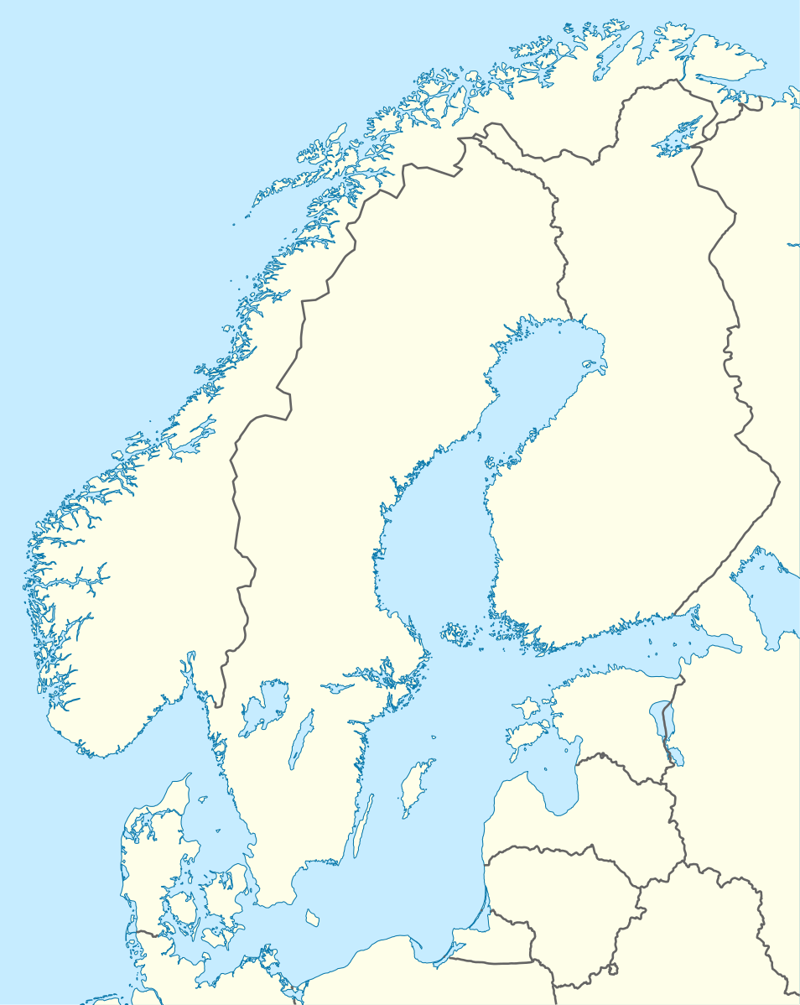



Prologue: It all began with borders…
My company ZiteLab is involved in a cross-Nordic collaboration.
Researchers in Denmark, Sweden and Norway are cooperating on Rheumatoid Arthritis (RA) research.
Local Data
Local Data
Local Data
Wikimedia:Scandinavia location map.svg

Slide 4
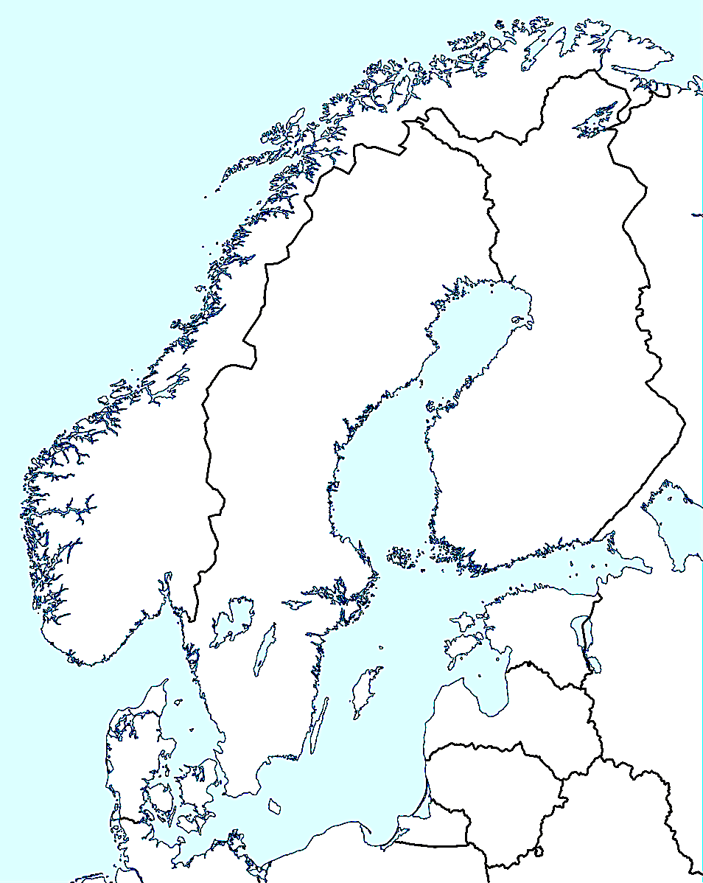
Prologue: It all began with borders…
The problem:
Personal Data Regulations prevent patient data from exiting the country of origin.
Local Data
Local Data
Local Data
Wikimedia:Scandinavia location map.svg

Slide 5
Prologue: It all began with borders…
The working solution has been performing statistics or modelling data locally.
Local Data
Local Model
Local Model
Local Data
Local Data
Local Model
Wikimedia:Scandinavia location map.svg

Slide 6
Enter Differential Privacy
Proposal: What if we used Differential Privacy to render data where individuals were no longer identifiable?
This would allows us to send data freely between centers.
Local Data
Local Data
Free Data
Local Data
Wikimedia:Scandinavia location map.svg

Slide 7
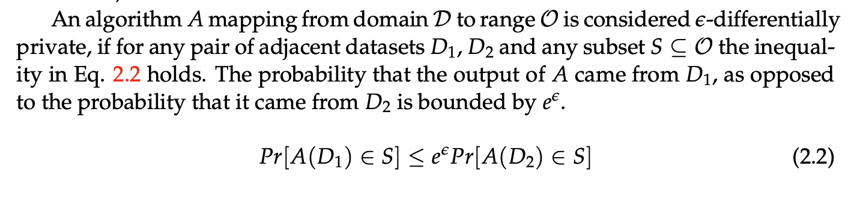
What is Differential Privacy?
𝛆 is the privacy budget / privacy loss parameter and can be controlled.
High 𝛆 means high utility, low privacy.
Low 𝛆 means low utility, high privacy.
We would like to balance 𝛆 such that it is no longer possible to tell if any person contributing to the output of the algorithm is certainly found in the dataset or not.
Notes:
Pages 6-10

Slide 8
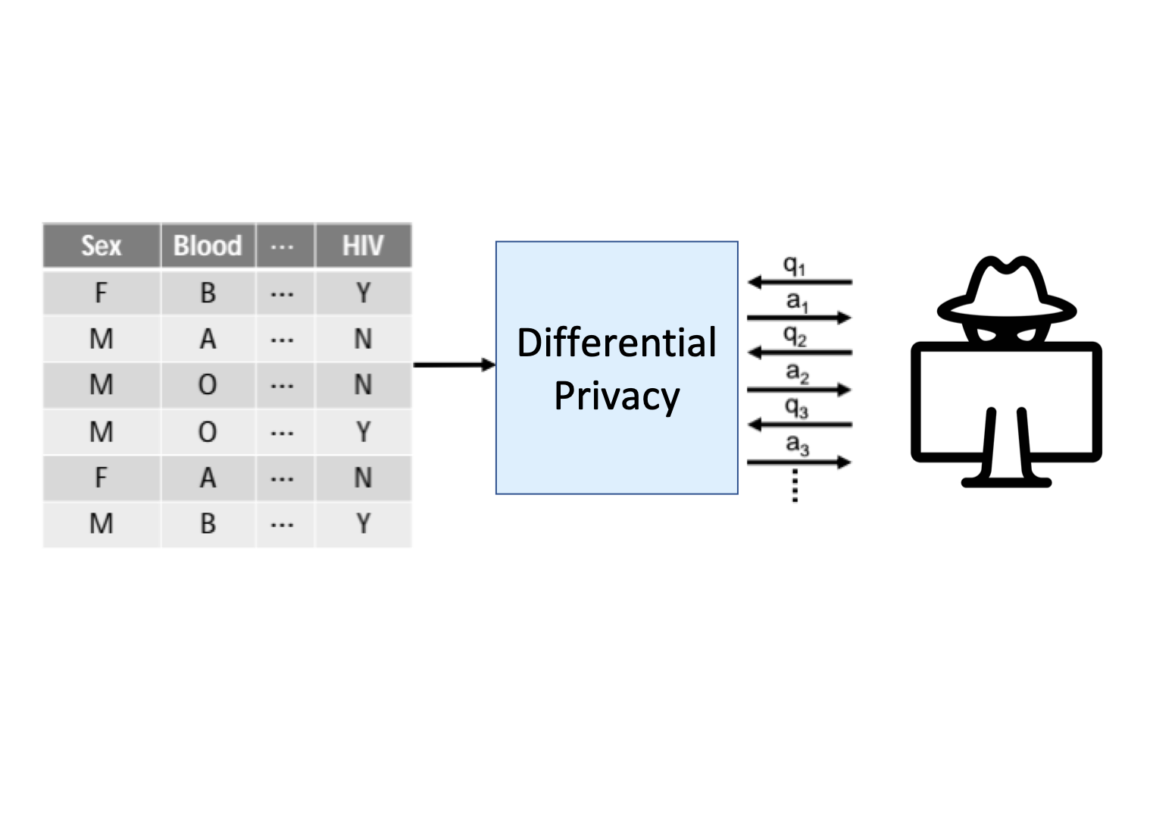
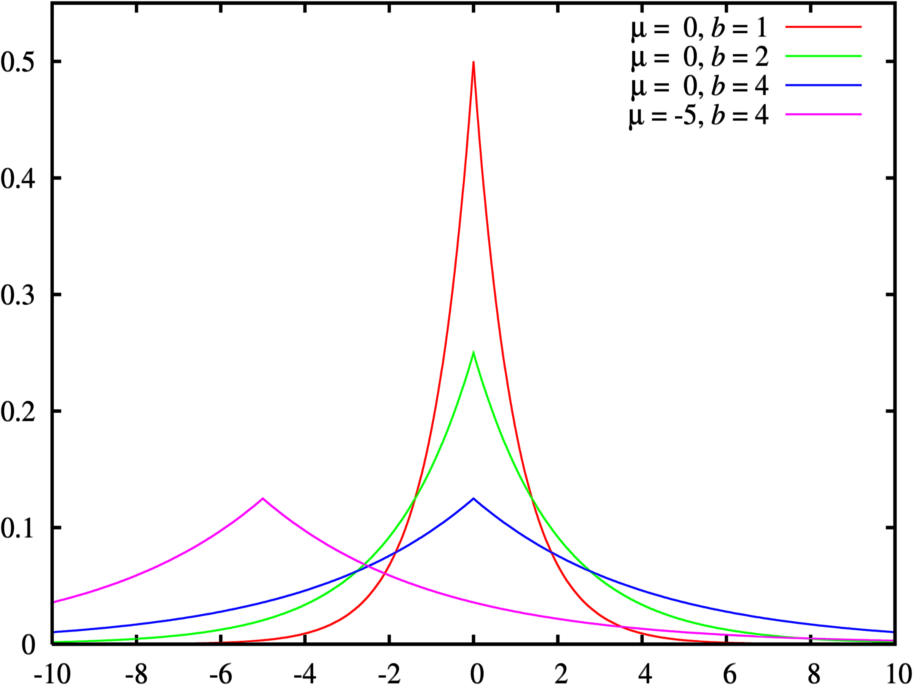
What is Differential Privacy?
An example of DP in action could be a querying-based system Where f.x. the number of Blood Type=A & HIV=Y individuals is reported with the addition of Laplacian Noise to add uncertainty.
OpenDP

Slide 9
Approaches to Differential Privacy
Approach | Pros | Cons
Tabular Perturbation | Straightforward to implement Allows us to separate “sensitive” attributes from “non-sensitive” | Not really DP Prior knowledge of the individuals can be used to reduce noise
Local Differential Privacy | Adequate for designing query-based systems. We only retain statistical counts, and nothing else. | Difficult to discover relationships between variables. Higher loss of utility compared to centralised DP

Slide 10
Approaches to Differential Privacy
Approach | Pros | Cons
Federated Learning (with Differential Privacy) | Instead of publishing data, we can coordinate machine learning modelling between centers. | Has to be done on an ad hoc basis Resource-intensive
DP Data Synthesis | Multi-Purpose: Classical Statistics and Machine Learning are possible. Do not have to know all intended queries prior | Utility and privacy are not as obvious to define Challenging to balance privacy and utility.

Slide 11

Initial Concerns
What if we are misinformed about trends in the sub-groups?
Can we trust data with so much noise?
Notes:
This is a picture of Irish parliament.

Slide 12
Research Questions
Given that we are generating synthetic clinical data
RQ1: Is there practical significance between algorithm selection along the privacy-utility trade-off?
RQ2: How much of a privacy budget is required for differential privacy to preserve the characteristics of population subgroups?

Slide 13
Background on DP

Slide 14
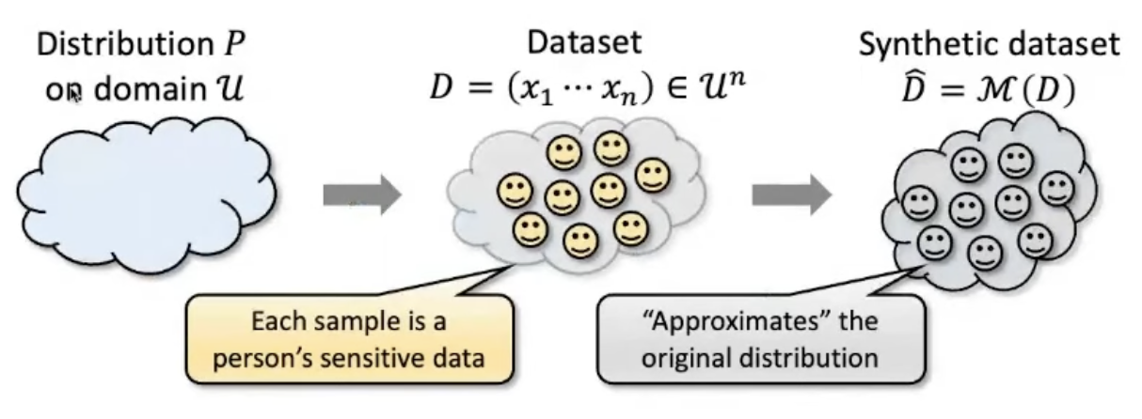
DP Data Synthesis
Jonathan Ullman

Slide 15
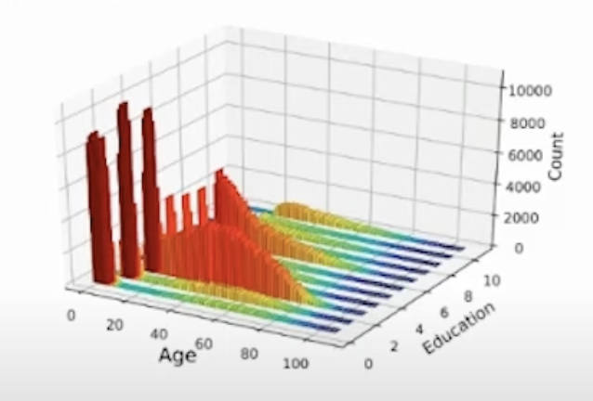
DP Data Synthesis with Marginals
A Marginal: a histogram over a subset of attributes.
Low-level representations of high level data.
Ryan McKenna
Notes:
Pages 8-10

Slide 16
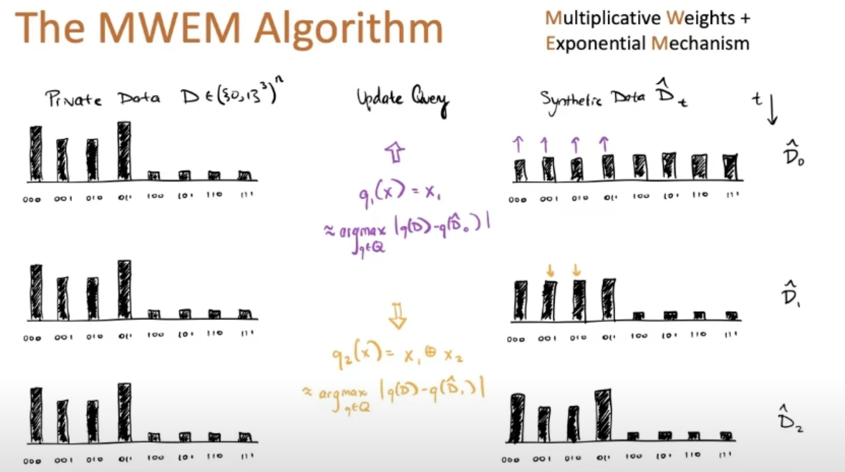
DP Data Synthesis with Marginals
Let us consider a simple version of the problem for a dataset of individuals with 3 binary features.
* 8 combinations in all
Jonathan Ullman

Slide 17
DP Data Synthesis with Marginals
Select queries.
Measure queries for private data.
Generate data to mimic measurements.
MWEM, MST and AIM
Ryan McKenna
Notes:
MWEM was the pioneering paper so I will primarily describe that.
0. Given initially a flat world where all combinations of data are equally likely to occur (n=n)
Query Selection, using the Exponential Mechanism we select a query from a list of pre-generated queries. Implementation specific, but generally speaking one-way or two-way marginal. EM ensures that we get a query where we expect a difference between the private data and our synthetic data
We use the Laplace Mechanism mentioned earlier to query the Private data. This gives us an approximate count.
We update our synthetic data to explain the count for the query on the private data. Splitting it across bins in the grid.

Slide 18
What about our data?

Slide 19
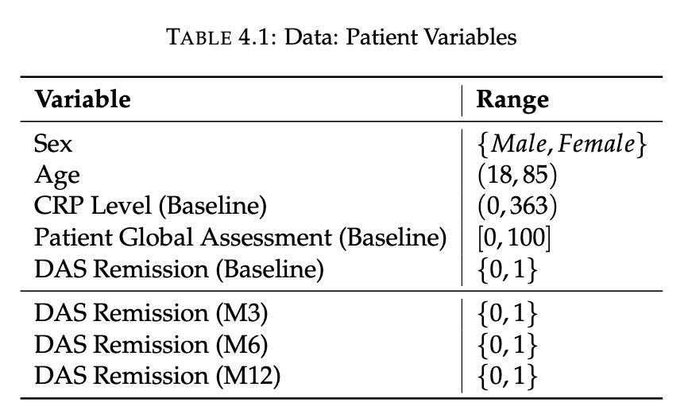
Data
A cohort of RA patients who receive an identical initial-treatment strategy.
1138 Patients
328 Males
810 Females
Notes:
Pages 13-14

Slide 20
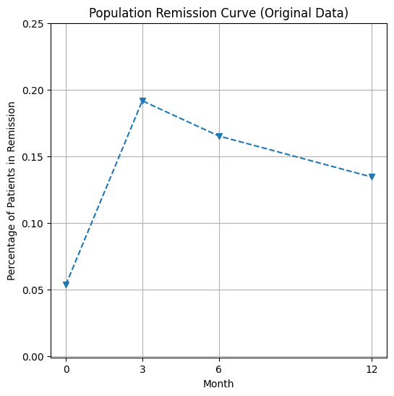
Remission Curves
The primary clinical outcome we are interested in for synthetic data is the population-wide remission.
In the original dataset, the treatment strategy allowed ~20% to achieve remission, but this was unsustained in later months.
Notes:
Page 15

Slide 21
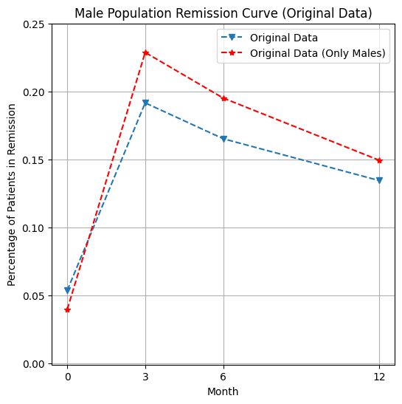
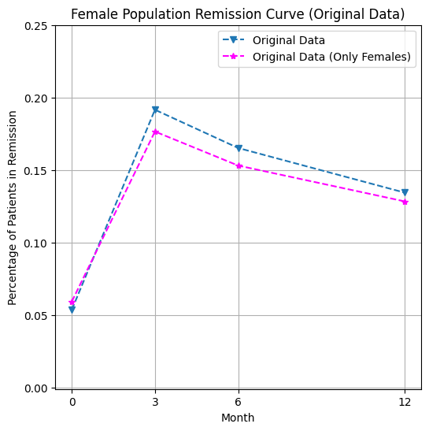
Remission Curves (Secondary Outcome: Subgroups)
Notes:
Page 16

Slide 22
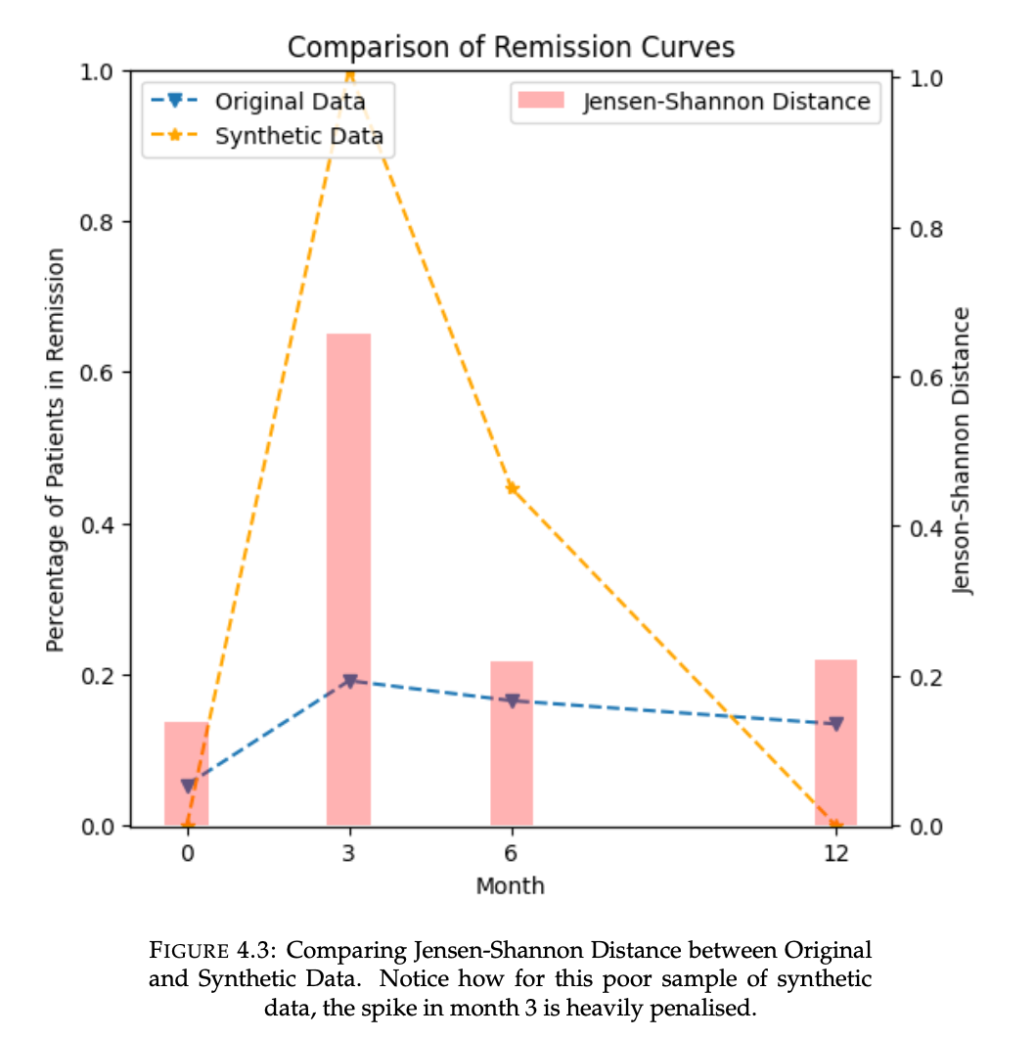
Measuring Utility
I treat the rates of remission at the monthly intervals as probabilities.
Jensen-Shannon distance is a way to compute the distance between two probabilities (as a symmetrical extension of the K-L divergence)
Notes:
Page 17

Slide 23
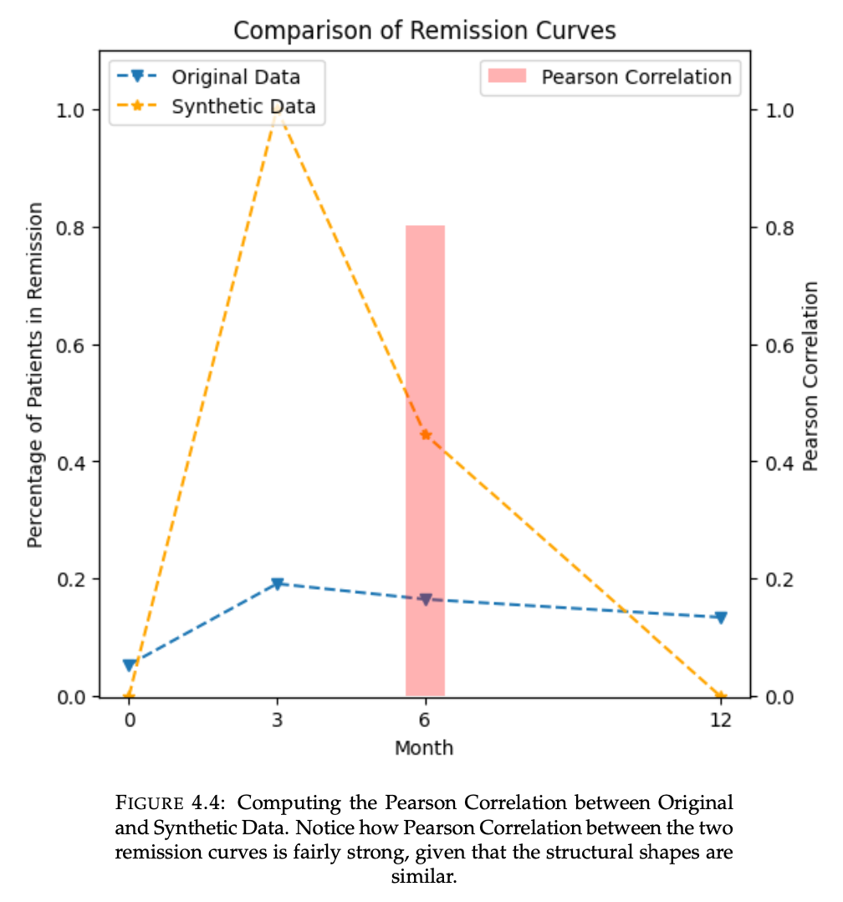
Measuring Utility
We can assume that synthetic data that mimics the original should be positively correlated.
Thus, Pearson’s Correlation shows the structural similarity of the remission curves.
Higher is better.
Notes:
Page 18

Slide 24
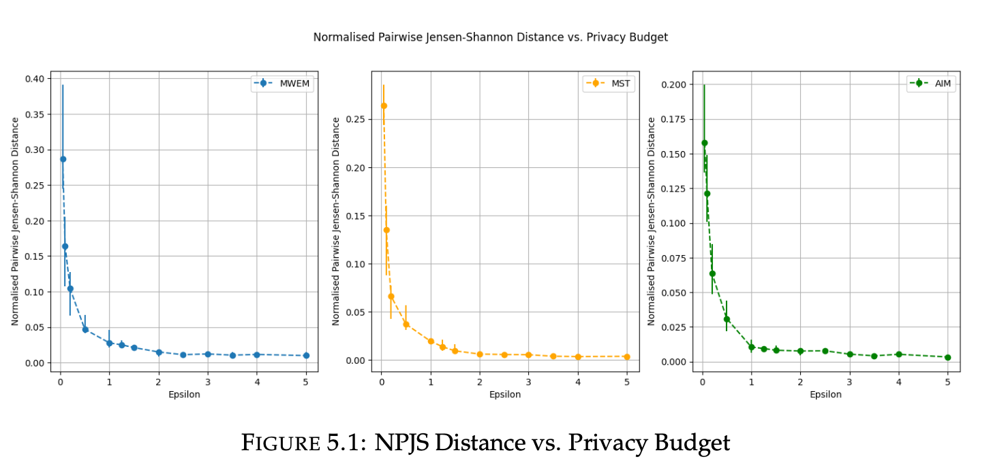
Results
Notes:
Pages 21-22
Here we have the three algorithms MWEM, MST and AIM varied across epsilon. And every dot indicates the median performance of 20 trials and the edges are the IQR (25/75)
In this section, I first report how well the remission curve for a whole synthetic dataset matched the remission curve for the whole original population. Figure 5.1 and Table 5.1 show a comparison of the privacy-utility trade-off when taking NPJS as the utility metric. Here, error bars are centered at the median utility of K = 20 trials, and span the 25th to 75th percentiles. Here, AIM clearly outperforms MWEM and MST as can be seen from the difference in magnitude on the y-axes of Figure 5.1.

Slide 25
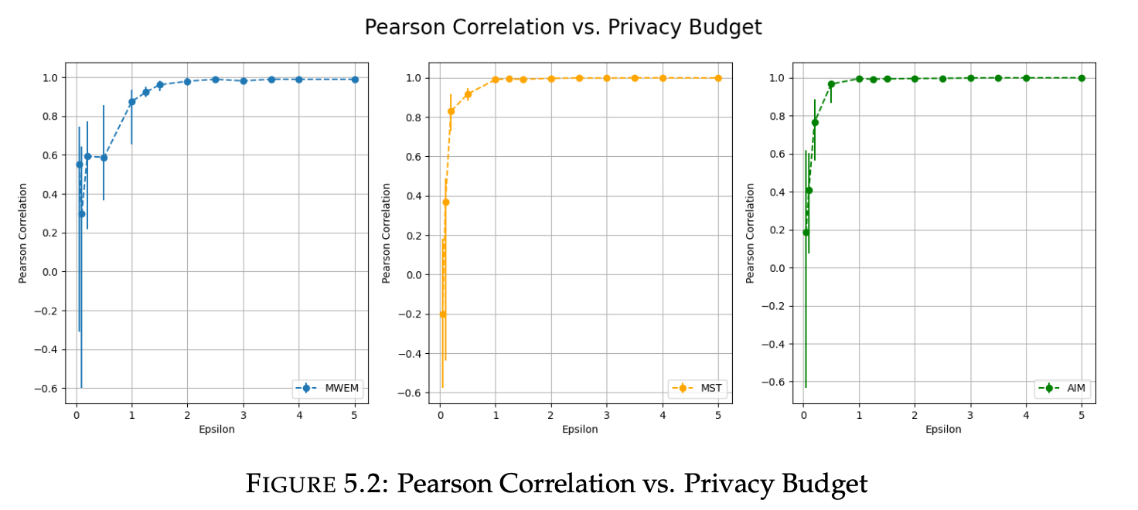
Results
Notes:
22-23
At ε ≤ 0.1, all three algorithms are seen to produce not only uncorrelated remission curves but even inversely correlated remission curves. There does not seem to a particularly good algorithm for maximising correlation, but by ε = 1.25 all three algorithms are shown to be able to consistently generate strongly positively correlated (> 0.75) remission curves.

Slide 26
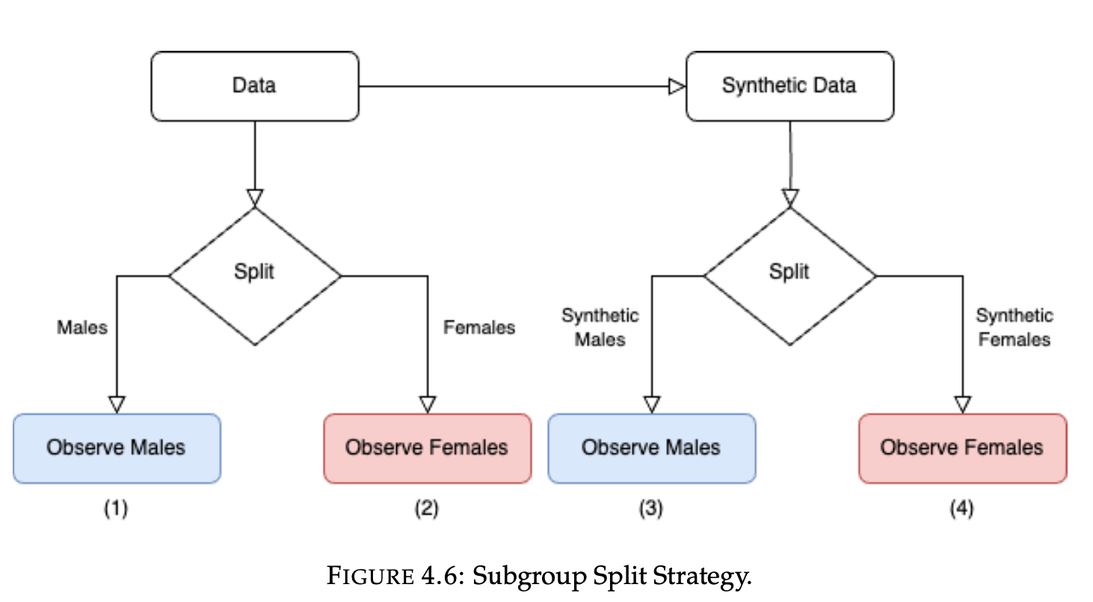
Results: Part 2
Notes:
Pages 24-31
A particular synthetic dataset

Slide 27
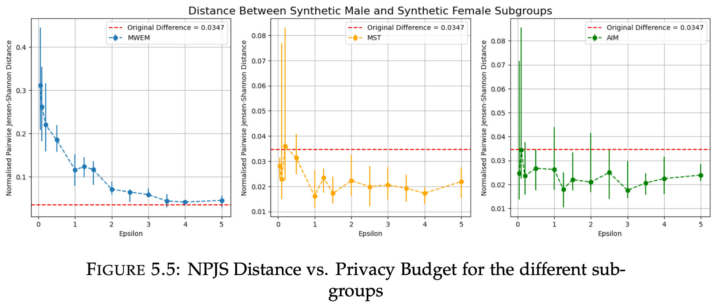
Results: Part 2
Notes:
Recall the remission curves for the men and women from earlier; red shows the line between the two.
Notice the red line at the bottom intercepting the y-axis; this is the NPJS distance between the original male and female subgroups (1-2). Ideally, the synthetic data should pre- cisely shoot for this level of similarity between the two groups, neither too above or below.
MST And AIM do lose variable importance at low epsilon, but MWEM exasberates the difference

Slide 28
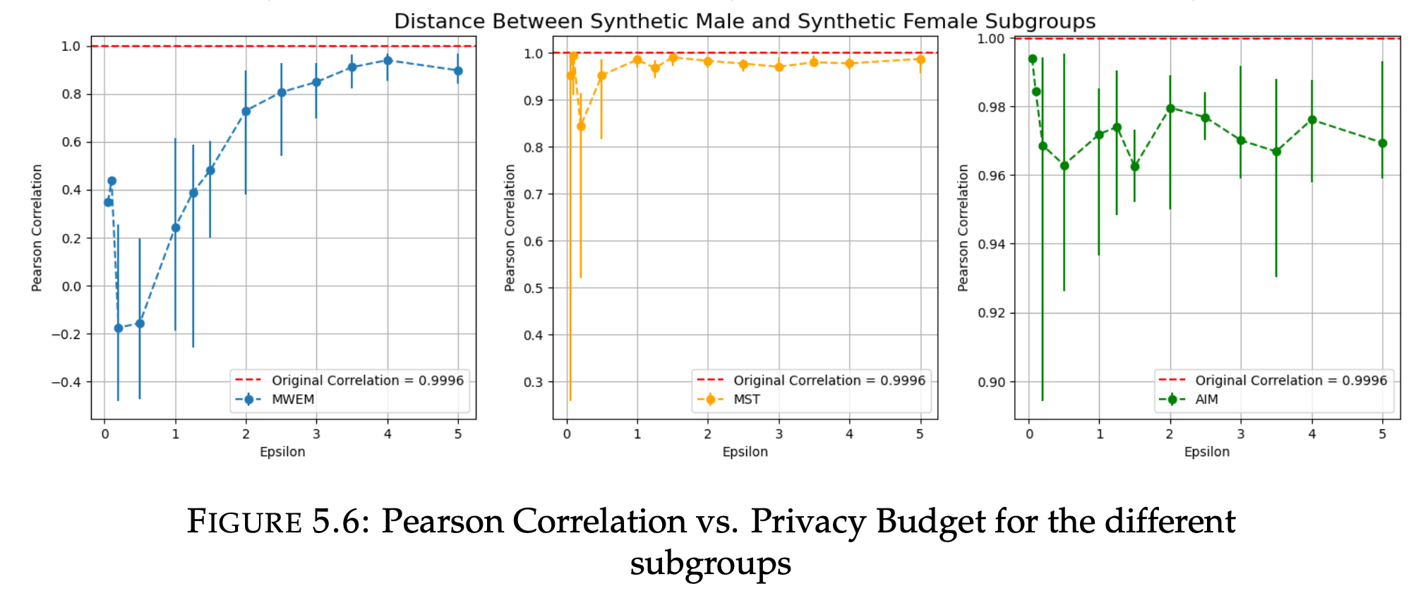
Results: Part 2
Notes:
Once more notice the red-line in the lower plots, this indicates the ideal baseline for the Pearson correlation between the remission curves of the male and female subgroups. Serendipitously, in the original cohort the responses to treatment were almost proportional to one another at every interval and therefore the correlation comes out to ≈ 1. The correlation between male and female subgroups’ remission curves is maximised by AIM.
MST And AIM do lose variable importance at low epsilon, but MWEM exasberates the difference

Slide 29
Results (in a nutshell)
Algorithm choice not only affects magnitude of utility in the average case, but also in the worst case performance.
At very low epsilon, it is possible for uncorrelated or anti-correlated remission curves to occur.

Slide 30
Results (in a nutshell)
Because data synthesis algorithms may never consider certain 2-way marginals, it’s possible for homogeneously male/female datasets.
“Variable importance loss” hypothesis held for AIM and MST; MWEM exaggerates differences between men and women.

Slide 31
Discussion
RQ1: Algorithm selection does decide behaviour of epsilon scale.
AIM and MST outperform MWEM.
RQ2: Trends common to the population are preserved from low values of epsilon, common among the majority at higher levels and then finally common among the minority at the highest levels.
Global remission curve can be approximated at lower epsilon (~1), the female remission curve at higher epsilon (~1.5) and finally the male remission curve at the highest levels of epsilon (~5).
Subgroup differences are preserved at (~1) for MST, AIM but require higher budget for MWEM which tends to overestimate.

Slide 32
Discussion: Further Questions

Slide 33
Thank you for listening!

Slide 34
Research Questions
For differentially private data synthesis, I design an experimental set-up (See Sec. 4.2) where I compare the remission rate of a population over 12 month’s time, between original clinical data and synthetically generated datasets. Given this experimental set-up I investigate the following research questions:
Given that we are generating synthetic clinical data
RQ1: Is there practical significance between algorithm selection along the privacy-utility trade-off?
RQ2: How much of a privacy budget is required for differential privacy to preserve the characteristics of population subgroups?

Slide 35
Results: Part 2

Slide 36
Results

Slide 37
Overview
Need for this Research
[Data: 1 slide]
Results
Discussion

Slide 38
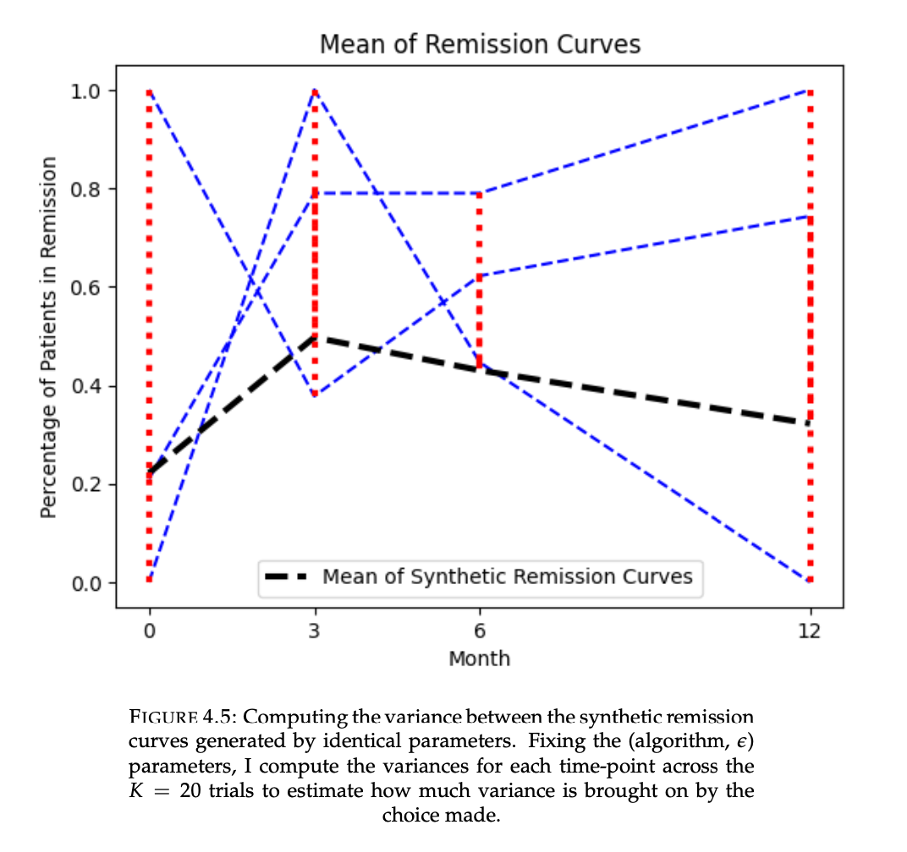
Measuring Utility

Slide 39
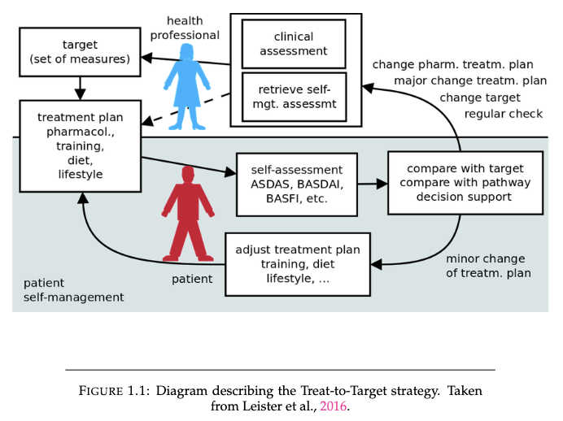
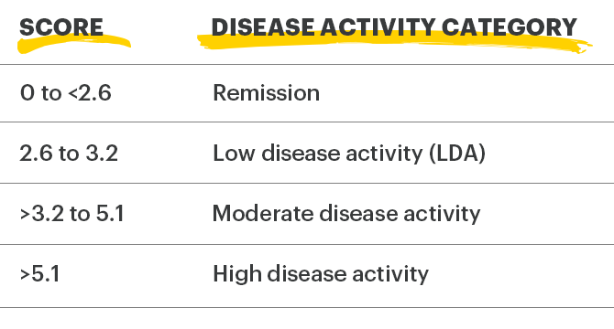
Prologue: How it all began
The ideal for an RA patient is to bring them to remission
FIX THIS TABLE

Slide 40
Prologue: How it all began
The ideal for an RA patient is to bring them to remission
FIX THIS TABLE

Slide 41
The State of DP
To develop a Differential Privacy algorithm for Multivariate Dataset Release.
Furthermore to assess the correspondence in statistical analyses between algorithmically released data and the original data.
We are also interested in subgroup analysis, on the male/female subgroups for both altered and original data.

Slide 42
About Rheumatoid Arthritis
Rheumatoid arthritis (RA) is a chronic and progressive auto-immune disorder that affects the joints, leading to inflammation, pain, and stiffness.

Slide 43
About Rheumatoid Arthritis
The ideal for an RA patient is to bring them to remission
FIX THIS TABLE

Slide 44
Challenge
Data Privacy Regulations make exchanging RA data difficult.
So I propose to use Differential Privacy as a means to render personal data private.

Slide 45
Aim of My Work
To develop a Differential Privacy algorithm for Multivariate Dataset Release.
Furthermore to assess the correspondence in statistical analyses between algorithmically released data and the original data.
We are also interested in subgroup analysis, on the male/female subgroups for both altered and original data.

Slide 46
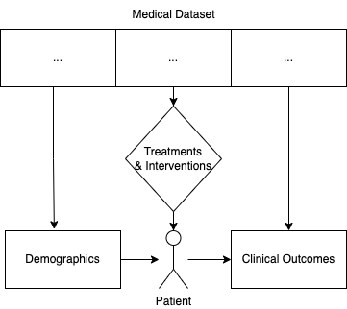
Approach: What Data Is Private
Clinical Outcomes are the interesting outcome. They are, however, sensitive data.
DAS28 Score, Patient Questionnaires
Demographics are quasi-identifiers.
Sex, Age
Treatments & Interventions are not necessarily private.
Drug (Anti-TNF), Supplements (Cortisone)

Slide 47
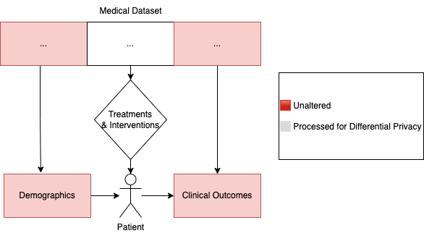
Approach: What Data Is Private
Approach: Target Demographics and Clinical Outcomes for Differential Privacy

Slide 48
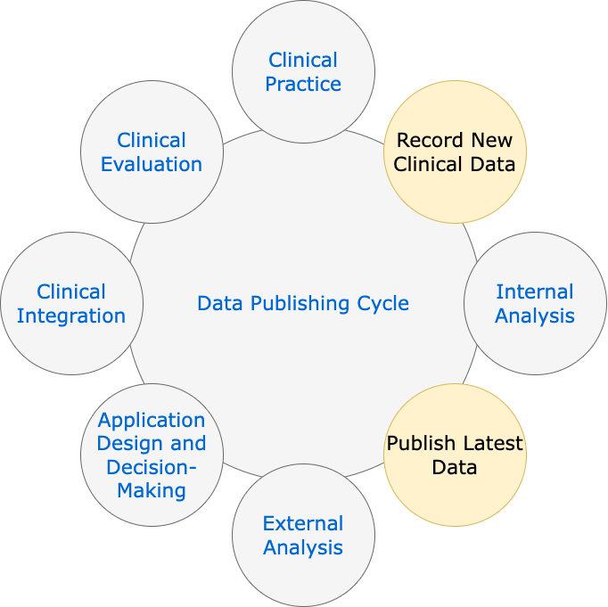
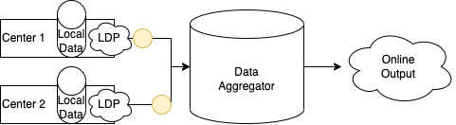
Approach: Building a Public Dataset from Private Data
Data Collection is cyclical and iterative.
New patients may be added to data over-time, and therefore an online algorithm is desirable.
Therefore Local Differential Privacy
Saves us from incurring penalties to epsilon, through re-releases of data.
Much higher perturbation than with Centralised DP.

Slide 49
Time to Switch Windows!

Slide 50
Challenges
Run multiple iterations, report loss metrics.
How to allocate Epsilon?
Grid-Search
Missing Data
Plentitude of missing data drops us from 10000 data points to some 2000.

